Slide 1
Credit Approval Model
-Arvind Thirugnanam

Slide 2
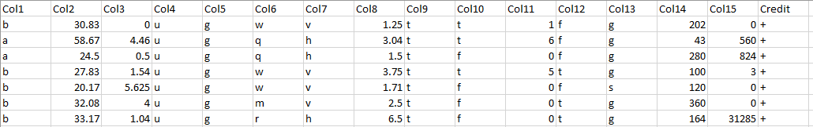
Data understanding:
The Credit Approval Data Set:
The Credit Approval data set has 16 Attributes and 690 Fields
It Depicts if a record has been Approved Credit or Not

Slide 3
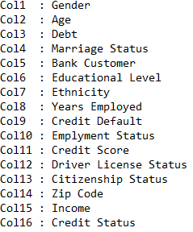
Column Names:

Slide 4
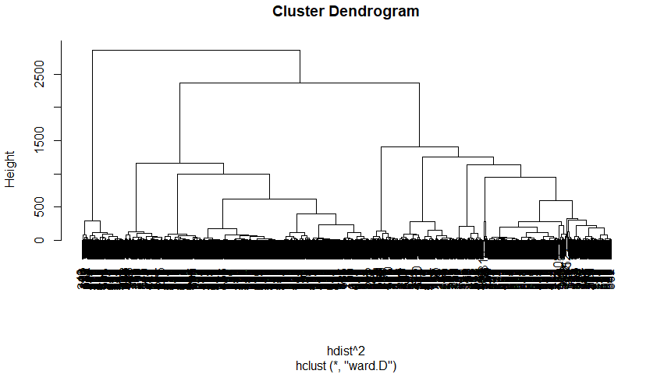
Data Preparation:
The following Cleaning Process were undertaken
1)Replaced the missing values with average of other values present in a attribute
2)Removed Multicollinearity
3)Performed Cluster and Factor Analysis to predict the model

Slide 5
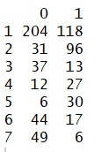
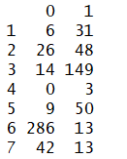
Cluster Analysis:
Hierarchical Cluster Analysis vs Credit Approval
K Means Cluster Analysis vs Credit Approval

Slide 6
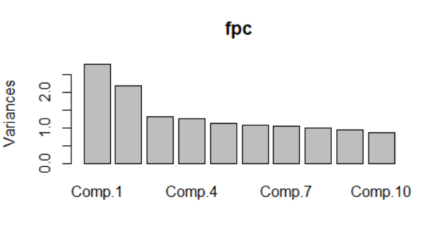
Factor Analysis: Principal Component
Principal Component was analysed to predict the number of factors required for Factor Analysis
There is an assumption of 5 factors to be considered

Slide 7
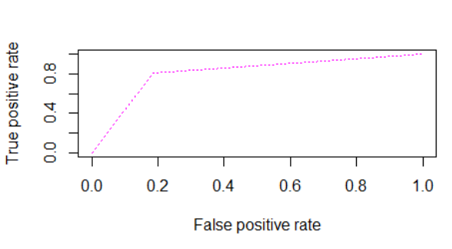
Factor Analysis with the Logistic Model:
A logistic regression model depicting the five factors effect on Credit
The AUC is 0.8098

Slide 8
Assumptions in my model:
Considered Fisher test(Pvalue>0.05) for Categorical Variables and Anova test(Pvalue>0.05) for Numerical Variables to remove the variables which doesn’t affect Credit Approval
Categorized few attributes to further analyse the results with Credit Approval

Slide 9
Data Modelling:
Performed Logistic Regression on Non Collinear Variables with Credit Approval Variable
The best model suggested that the variables which depicts Credit Default Status , Employment Status and Income best depicts if a Credit will be Approved or not

Slide 10

The Model:
The Logistic Model of Actual and Predicted Values

Slide 11
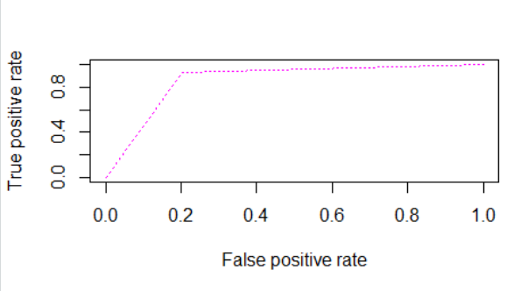
Performance of the Model:
The Logistic Model depicting the ROC Curve
The AUC of the model is 0.8623

Slide 12
Validation:
Split the data into Test(40%) and Train(60%)
Ran the complete analysis and observed the results

Slide 13

Train Model:
The Train Logistic Model of Actual and Predicted Values Of Credit Approval

Slide 14
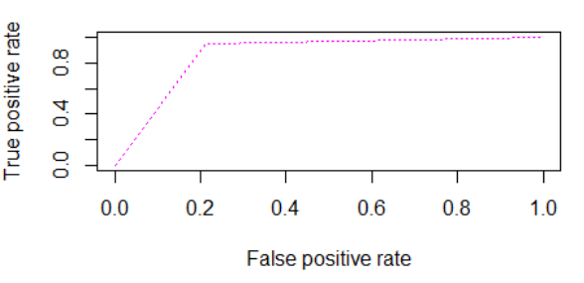
Performance Of Train Model:
The ROC curve of Train Model
The AUC is 0.871

Slide 15

Test Model:
The Test Logistic Model of Actual and Predicted Values Of Credit Approval

Slide 16
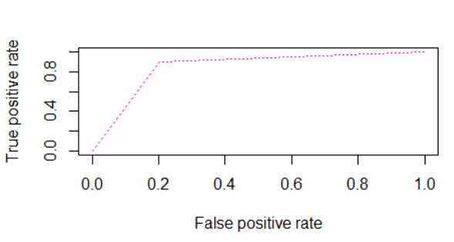
Performance Of Test Model
The ROC curve of Train Model
The AUC is 0.8456

Slide 17
Inferences:
Comparing the values of AUC of the Overall Model(0.8623) with Train(0.871 )and Test(0.8456 )model , it seems to be nearly similar and the Accuracy, Specificity and Sensitivity of Test, Train and the Overall Model are below:
Test<-Accuracy-84.4% Specificity-79.5% and Sensitivity-89.5%
Train<-Accuracy-85.74% Specificity-78.8% and Sensitivity-95.3%
Overall Model<-Accuracy-85.3% Specificity-79.3% and Sensitivity-92.8%
The somersD values of the Overall Model , Train Model and the Test Model are respectively 0.4785 , 0.5038 and 0.4252 which seems to be nearly similar as well
The model was cross validated with Boot Strap Method, K Fold Method and Jack Knifing Method which signifies that only three parameters i.e. Credit Default Status, Employment Status and Income best describes the Credit Approval
Thus my model Predicts that for the credit to be approved or disapproved in this data set, it can be best predicted using Credit Default Status , Employment Status and Income data

Slide 18


Inference of Credit Default Status Versus My Model and Actual Credit in the Data Set
0 - Defaults from Credit
1 - Doesn’t Default from Credit
Credit Default Status versus My Model
Credit Default Status versus Actual Credit

Slide 19


Inference of Employment Status Versus My Model and Actual Credit in the Data Set
0 - Unemployed
1 - Employed
Employment Status vs My Model
Employment Status vs Actual Credit

Slide 20
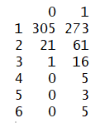
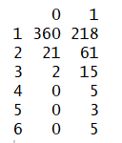
Inference of Income Versus My Model and Actual Credit in the Data Set
Income Categories
0 – 1000 : 1
1000 – 5000 : 2
5000 – 10000 : 3
10000– 15000 : 4
15000 – 20000 : 5
>20000 : 6
Income vs My Model
Income vs Actual Credit

Slide 21
Thank You

